Slide 1


CREDIT CARD SALES ANALYSIS
WEEKLY STATUS
REPORT

Slide 2


CONTENTS
Project Objective
Data from SQL
Project Insights
Outro

Slide 3

Project Objective
To develop a comprehensive credit
card weekly dashboard that
provides real-time insights into key
performance metrics and trends,
enabling stakeholders to monitor
and analyze credit card operations
effectively.

Slide 4
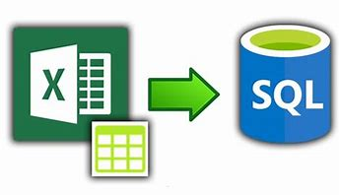
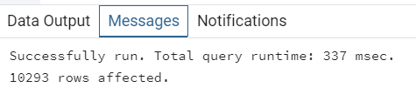
Import data to SQL database
1. Prepare csv file
2. Create tables in SQL
3. import csv file into SQL

Slide 5
Project Insights- Week 53 (31st Dec)
WoW change:
• Revenue increased by 28.8%,
• Total Transaction Amt & Count increased by 74% & 88%
• Customer count increased by 88%
Overview YTD:
• Overall revenue is 57M
• Total interest is 8M
• Total transaction amount is 46M
• Male customers are contributing more in revenue 31M, female 26M
• Blue & Silver credit card are contributing to 93% of overall
transactions
• TX, NY & CA is contributing to 68%
• Overall Activation rate is 57.5%
• Overall Delinquent rate is 6.06% and “Self Employed” are having the highest number of Delinquent rate.

Slide 6



If you have any query, suggestions or feedback, please reach me out at any of these, any time. I would love to help you out.
Thank You
https://www.linkedin.com/in/abhijeet-ranjan-958760191/
https://peerlist.io/abhijeetranjan
abhijeetr162@gmail.com

